Slide 1
Timeline
Remaining lectures
  2 lectures on machine learning (today and next Thursday)
  No lecture next Tuesday Dec 4th (out of town)
Homeworks
  #5 (Bayesian networks) is due today
  #6 (machine learning) will be out shortly, due end of next week
Final exam
  2 weeks from Thursday
    In class, closed-book, cumulative but with emphasis on logic onwards
    Will discuss more abou tthis next Thursday

Slide 2
Naïve Bayes Model (p718 in text)
Y₁
Y₂
Y₃
Y_{n}
C
P(C | Y₁,…Y_{n}) = α Π P(Y_{i} | C) P (C)
Features Y are conditionally independent given the class variable C
Widely used in machine learning
e.g., spam email classification: Y’s = counts of words in emails
Conditional probabilities P(Yi | C) can easily be estimated from labeled data

Slide 3
Hidden Markov Model (HMM)
Observed
Y₁
Y₂
Y₃
Y_{n}
- - - - - - - - - - - - - - - - - - - - - - - - - - - - - - - - - - - - - - - - - - - - - - - - - - - -
S₃
S_{n}
Hidden
S₁
S₂
Two key assumptions:
1. hidden state sequence is Markov
2. observation Y_{t} is CI of all other variables given S_{t}
Widely used in speech recognition, protein sequence models
Since this is a Bayesian network polytree, inference is linear in n

Slide 4
Intoduction to Machine Learning
CS 271: Fall 2007
Instructor: Padhraic Smyth

Slide 5
Outline
Different types of learning problems
Different types of learning algorithms
Supervised learning
  Decision trees
  Naïve Bayes
  Perceptrons, Multi-layer Neural Networks
  Boosting
Unsupervised Learning
  K-means
Applications: learning to detect faces in images
Reading for today’s lecture: Chapter 18.1 to 18.4 (inclusive)

Slide 6
Automated Learning
Why is it useful for our agent to be able to learn?
  Learning is a key hallmark of intelligence
  The ability of an agent to take in real data and feedback and improve performance over time
Types of learning
  Supervised learning
    Learning a mapping from a set of inputs to a target variable
      Classification: target variable is discrete (e.g., spam email)
      Regression: target variable is real-valued (e.g., stock market)
  Unsupervised learning
    No target variable provided
      Clustering: grouping data into K groups
  Other types of learning
    Reinforcement learning: e.g., game-playing agent
    Learning to rank, e.g., document ranking in Web search
    And many others….

Slide 7
Simple illustrative learning problem
Problem:
decide whether to wait for a table at a restaurant, based on the following attributes:
  Alternate: is there an alternative restaurant nearby?
  Bar: is there a comfortable bar area to wait in?
  Fri/Sat: is today Friday or Saturday?
  Hungry: are we hungry?
  Patrons: number of people in the restaurant (None, Some, Full)
  Price: price range ($, $$, $$$)
  Raining: is it raining outside?
  Reservation: have we made a reservation?
  Type: kind of restaurant (French, Italian, Thai, Burger)
  WaitEstimate: estimated waiting time (0-10, 10-30, 30-60, >60)

Slide 8
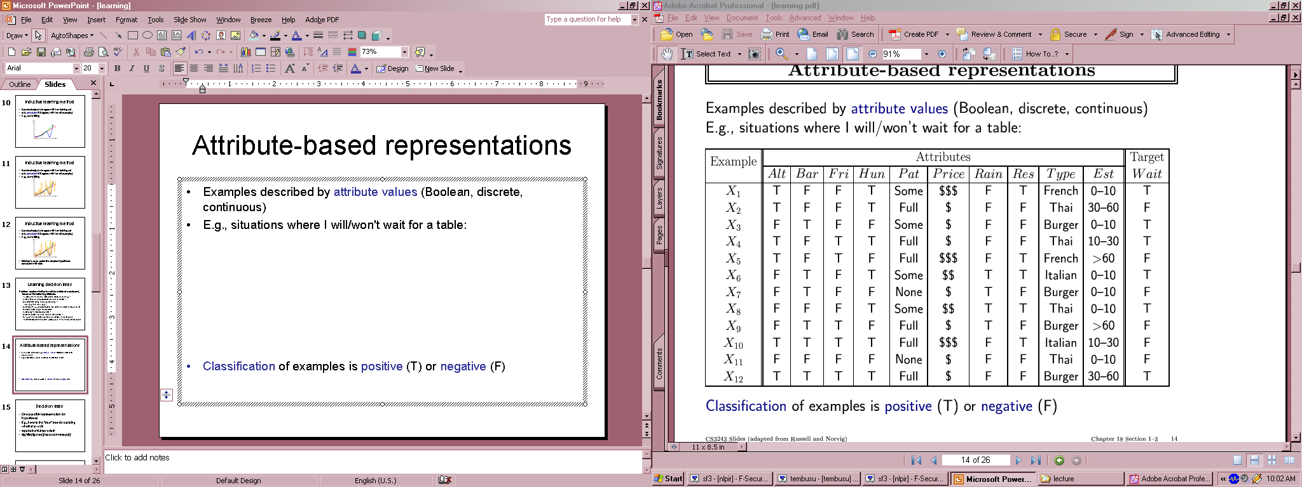
Training Data for Supervised Learning

Slide 9
Terminology
Attributes
  Also known as features, variables, independent variables, covariates
Target Variable
  Also known as goal predicate, dependent variable, …
Classification
  Also known as discrimination, supervised classification, …
Error function
  Objective function, loss function, …

Slide 10
Inductive learning
Let x represent the input vector of attributes
Let f(x) represent the value of the target variable for x
  The implicit mapping from x to f(x) is unknown to us
  We just have training data pairs, D = {x, f(x)} available
We want to learn a mapping from x to f, i.e.,
h(x; θ) is “close” to f(x) for all training data points x
θ are the parameters of our predictor h(..)
Examples:
  h(x; θ) = sign(w₁x₁ + w₂x₂+ w₃)
  h_{k}(x) = (x1 OR x2) AND (x3 OR NOT(x4))

Slide 11
Empirical Error Functions
Empirical error function:
  E(h) = Σ_{x} distance[h(x; θ) , f]
  e.g., distance = squared error if h and f are real-valued (regression)
  distance = delta-function if h and f are categorical (classification)
  Sum is over all training pairs in the training data D
  In learning, we get to choose
  1. what class of functions h(..) that we want to learn
  – potentially a huge space! (“hypothesis space”)
  2. what error function/distance to use
  - should be chosen to reflect real “loss” in problem
  - but often chosen for mathematical/algorithmic convenience

Slide 12
Inductive Learning as Optimization or Search
Empirical error function:
  E(h) = Σ_{x} distance[h(x; θ) , f]
Empirical learning = finding h(x), or h(x; θ) that minimizes E(h)
  In simple problems there may be a closed form solution
    E.g., “normal equations” when h is a linear function of x, E = squared error
  If E(h) is differentiable as a function of q, then we have a continuous optimization problem and can use gradient descent, etc
    E.g., multi-layer neural networks
  If E(h) is non-differentiable (e.g., classification), then we typically have a systematic search problem through the space of functions h
    E.g., decision tree classifiers
Once we decide on what the functional form of h is, and what the error function E is, then machine learning typically reduces to a large search or optimization problem
Additional aspect: we really want to learn an h(..) that will generalize well to new data, not just memorize training data – will return to this later

Slide 13
Our training data example (again)
If all attributes were binary, h(..) could be any arbitrary Boolean function
Natural error function E(h) to use is classification error, i.e., how many incorrect predictions does a hypothesis h make
Note an implicit assumption:
  For any set of attribute values there is a unique target value
  This in effect assumes a “no-noise” mapping from inputs to targets
    This is often not true in practice (e.g., in medicine). Will return to this later

Slide 14
Learning Boolean Functions
Given examples of the function, can we learn the function?
How many Boolean functions can be defined on d attributes?
  Boolean function = Truth table + column for target function (binary)
  Truth table has 2^{d} rows
  So there are 2 to the power of 2^{d} different Boolean functions we can define (!)
  This is the size of our hypothesis space
  E.g., d = 6, there are 18.4 x 10¹⁸ possible Boolean functions
Observations:
  Huge hypothesis spaces –> directly searching over all functions is impossible
  Given a small data (n pairs) our learning problem may be underconstrained
    Ockham’s razor: if multiple candidate functions all explain the data equally well, pick the simplest explanation (least complex function)
    Constrain our search to classes of Boolean functions, e.g.,
      decision trees
      Weighted linear sums of inputs (e.g., perceptrons)

Slide 15
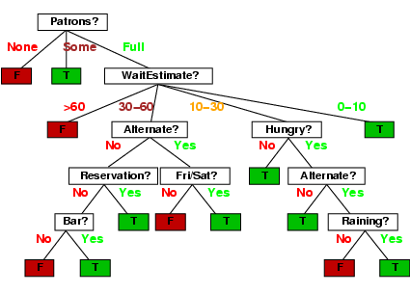
Decision Tree Learning
Constrain h(..) to be a decision tree

Slide 16
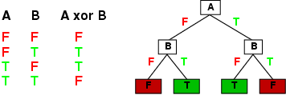
Decision Tree Representations
Decision trees are fully expressive
  can represent any Boolean function
  Every path in the tree could represent 1 row in the truth table
  Yields an exponentially large tree
    Truth table is of size 2^{d}, where d is the number of attributes

Slide 17
Decision Tree Representations
Trees can be very inefficient for certain types of functions
  Parity function: 1 only if an even number of 1’s in the input vector
    Trees are very inefficient at representing such functions
  Majority function: 1 if more than ½ the inputs are 1’s
    Also inefficient
  Simple DNF formulae can be easily represented
    E.g., f = (A AND B) OR (NOT(A) AND D)
    DNF = disjunction of conjunctions
Decision trees are in effect DNF representations
  often used in practice since they often result in compact approximate representations for complex functions
  E.g., consider a truth table where most of the variables are irrelevant to the function

Slide 18
Decision Tree Learning
Find the smallest decision tree consistent with the n examples
  Unfortunately this is provably intractable to do optimally
Greedy heuristic search used in practice:
  Select root node that is “best” in some sense
  Partition data into 2 subsets, depending on root attribute value
  Recursively grow subtrees
  Different termination criteria
    For noiseless data, if all examples at a node have the same label then declare it a leaf and backup
    For noisy data it might not be possible to find a “pure” leaf using the given attributes
      we’ll return to this later – but a simple approach is to have a depth-bound on the tree (or go to max depth) and use majority vote
We have talked about binary variables up until now, but we can trivially extend to multi-valued variables

Slide 19
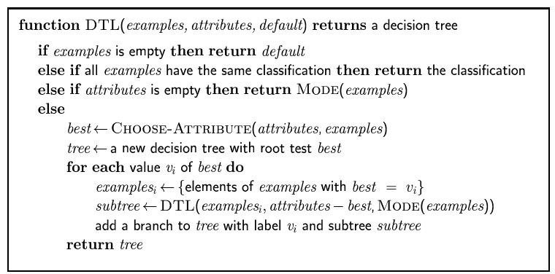
Pseudocode for Decision tree learning

Slide 20
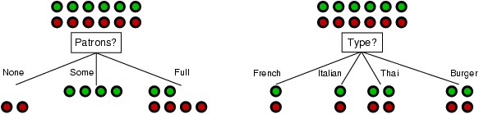
Choosing an attribute
Idea: a good attribute splits the examples into subsets that are (ideally) "all positive" or "all negative"
Patrons? is a better choice
  How can we quantify this?
  One approach would be to use the classification error E directly (greedily)
    Empirically it is found that this works poorly
  Much better is to use information gain (next slides)

Slide 21
Entropy
H(p) = entropy of distribution p = {p_{i}}
        (called “information” in text)
  = E [p_{i} log (1/p_{i}) ] = - p log p - (1-p) log (1-p)
  Intuitively log 1/p_{i} is the amount of information we get when we find out that outcome i occurred, e.g.,
  i = “6.0 earthquake in New York today”, p(i) = 1/2²⁰
  log 1/p_{i} = 20 bits
  j = “rained in New York today”, p(i) = ½
  log 1/p_{j} = 1 bit
  Entropy is the expected amount of information we gain, given a probability distribution – its our average uncertainty
  In general, H(p) is maximized when all p_{i} are equal and minimized (=0) when one of the p_{i}’s is 1 and all others zero.

Slide 22
Entropy with only 2 outcomes
  Consider 2 class problem: p = probability of class 1, 1 – p = probability of class 2
  In binary case, H(p) = - p log p - (1-p) log (1-p)
H(p)
1
0
0.5
1
p

Slide 23
Information Gain
H(p) = entropy of class distribution at a particular node
H(p | A) = conditional entropy = average entropy of conditional class distribution, after we have partitioned the data according to the values in A
Gain(A) = H(p) – H(p | A)
Simple rule in decision tree learning
  At each internal node, split on the node with the largest information gain (or equivalently, with smallest H(p|A))
Note that by definition, conditional entropy can’t be greater than the entropy

Slide 24
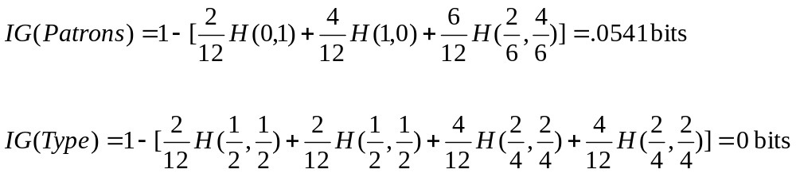
Root Node Example
For the training set, 6 positives, 6 negatives, H(6/12, 6/12) = 1 bit
Consider the attributes Patrons and Type:
Patrons has the highest IG of all attributes and so is chosen by the learning algorithm as the root
Information gain is then repeatedly applied at internal nodes until all leaves contain only examples from one class or the other

Slide 25
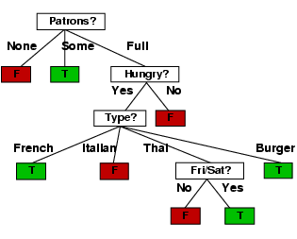
Decision Tree Learned
Decision tree learned from the 12 examples:

Slide 26
True Tree (left) versus Learned Tree (right)

Slide 27
Assessing Performance
Training data performance is typically optimistic
e.g., error rate on training data
Reasons?
- classifier may not have enough data to fully learn the concept (but
on training data we don’t know this)
- for noisy data, the classifier may overfit the training data
In practice we want to assess performance “out of sample”
how well will the classifier do on new unseen data? This is the
true test of what we have learned (just like a classroom)
With large data sets we can partition our data into 2 subsets, train and test
- build a model on the training data
- assess performance on the test data

Slide 28
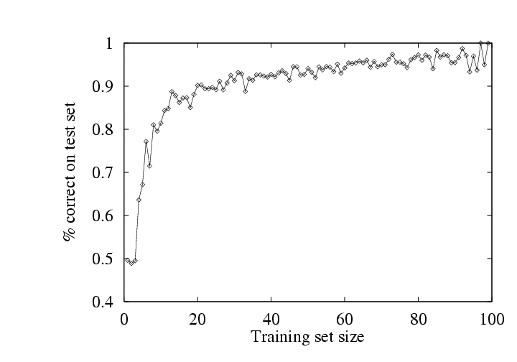
Example of Test Performance
Restaurant problem
- simulate 100 data sets of different sizes
- train on this data, and assess performance on an independent test set
- learning curve = plotting accuracy as a function of training set size
- typical “diminishing returns” effect (some nice theory to explain this)

Slide 29
Overfitting and Underfitting
Y
X

Slide 30
A Complex Model
Y = high-order polynomial in X
Y
X

Slide 31
A Much Simpler Model
Y = a X + b + noise
Y
X

Slide 32
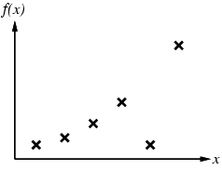
Example 2

Slide 33
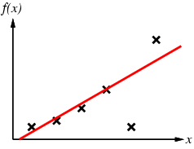
Example 2

Slide 34
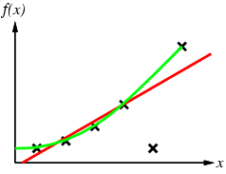
Example 2

Slide 35
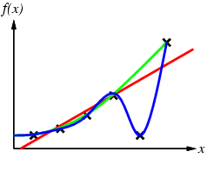
Example 2

Slide 36
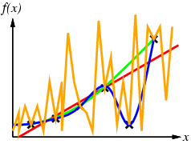
Example 2

Slide 37
How Overfitting affects Prediction
Predictive
Error
Error on Training Data
Model Complexity

Slide 38
How Overfitting affects Prediction
Predictive
Error
Error on Test Data
Error on Training Data
Model Complexity

Slide 39
How Overfitting affects Prediction
Underfitting
Overfitting
Predictive
Error
Error on Test Data
Error on Training Data
Model Complexity
Ideal Range
for Model Complexity

Slide 40
Training and Validation Data
Full Data Set
Idea: train each
model on the
“training data”
and then test
each model’s
accuracy on
the validation data
Training Data
Validation Data

Slide 41
The v-fold Cross-Validation Method
Why just choose one particular 90/10 “split” of the data?
  In principle we could do this multiple times
“v-fold Cross-Validation” (e.g., v=10)
  randomly partition our full data set into v disjoint subsets (each roughly of size n/v, n = total number of training data points)
    for i = 1:10 (here v = 10)
      train on 90% of data,
      Acc(i) = accuracy on other 10%
    end
    Cross-Validation-Accuracy = 1/v Σ_{i} Acc(i)
  choose the method with the highest cross-validation accuracy
  common values for v are 5 and 10
  Can also do “leave-one-out” where v = n

Slide 42
Disjoint Validation Data Sets
Full Data Set
Validation Data
Training Data
1st partition

Slide 43
Disjoint Validation Data Sets
Full Data Set
Validation Data
Validation
Data
Training Data
1st partition
2nd partition

Slide 44
More on Cross-Validation
Notes
  cross-validation generates an approximate estimate of how well the learned model will do on “unseen” data
  by averaging over different partitions it is more robust than just a single train/validate partition of the data
  “v-fold” cross-validation is a generalization
    partition data into disjoint validation subsets of size n/v
    train, validate, and average over the v partitions
    e.g., v=10 is commonly used
  v-fold cross-validation is approximately v times computationally more expensive than just fitting a model to all of the data

Slide 45
Learning to Detect Faces
(This material is not in the text: for details see paper by
P. Viola and M. Jones, International Journal of Computer Vision, 2004

Slide 46
Viola-Jones Face Detection Algorithm
Overview :
  Viola Jones technique overview
  Features
  Integral Images
  Feature Extraction
  Weak Classifiers
  Boosting and classifier evaluation
  Cascade of boosted classifiers
  Example Results

Slide 47
Viola Jones Technique Overview
Three major contributions/phases of the algorithm :
  Feature extraction
  Learning using boosting and decision stumps
  Multi-scale detection algorithm
Feature extraction and feature evaluation.
  Rectangular features are used, with a new image representation their calculation is very fast.
Classifier learning using a method called AdaBoost.
A combination of simple classifiers is very effective

Slide 48
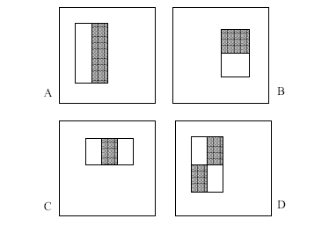
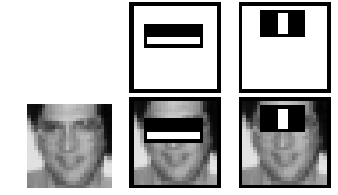
Features
Four basic types.
  They are easy to calculate.
  The white areas are subtracted from the black ones.
  A special representation of the sample called the integral image makes feature extraction faster.

Slide 49
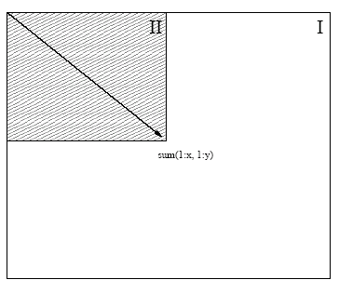
Integral images
Summed area tables
A representation that means any rectangle’s values can be calculated in four accesses of the integral image.

Slide 50
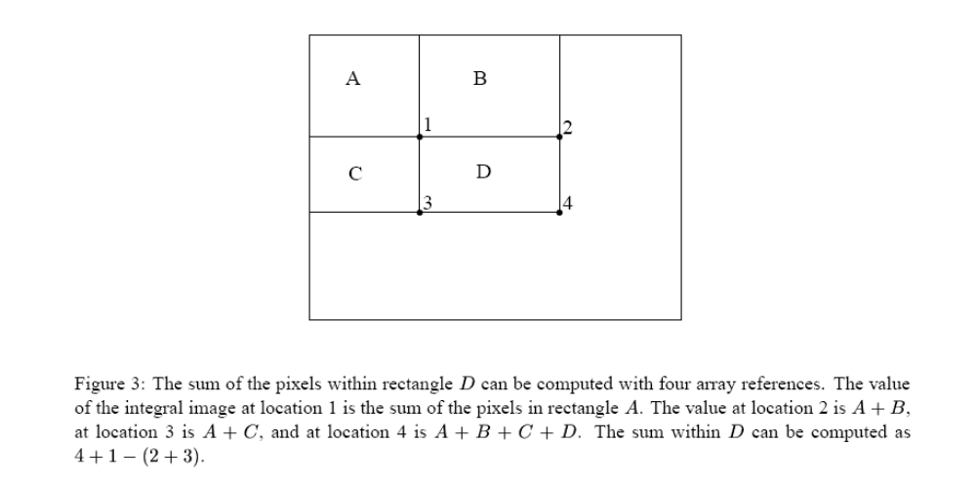
Fast Computation of Pixel Sums

Slide 51
Feature Extraction
Features are extracted from sub windows of a sample image.
  The base size for a sub window is 24 by 24 pixels.
  Each of the four feature types are scaled and shifted across all possible combinations
    In a 24 pixel by 24 pixel sub window there are ~160,000 possible features to be calculated.

Slide 52
Learning with many features
We have 160,000 features – how can we learn a classifier with only a few hundred training examples without overfitting?
Idea:
  Learn a single very simple classifier (a “weak classifier”)
  Classify the data
  Look at where it makes errors
  Reweight the data so that the inputs where we made errors get higher weight in the learning process
  Now learn a 2nd simple classifier on the weighted data
  Combine the 1st and 2nd classifier and weight the data according to where they make errors
  Learn a 3rd classifier on the weighted data
  … and so on until we learn T simple classifiers
  Final classifier is the combination of all T classifiers
  This procedure is called “Boosting” – works very well in practice.

Slide 53
“Decision Stumps”
Decision stumps = decision tree with only a single root node
  Certainly a very weak learner!
  Say the attributes are real-valued
  Decision stump algorithm looks at all possible thresholds for each attribute
  Selects the one with the max information gain
  Resulting classifier is a simple threshold on a single feature
    Outputs a +1 if the attribute is above a certain threshold
    Outputs a -1 if the attribute is below the threshold
  Note: can restrict the search for to the n-1 “midpoint” locations between a sorted list of attribute values for each feature. So complexity is n log n per attribute.

Slide 54
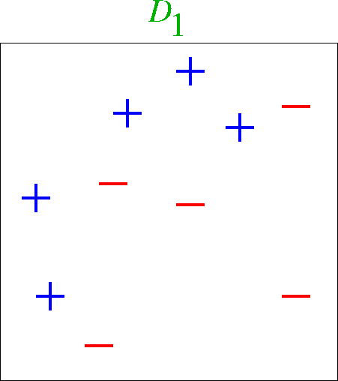
Boosting Example

Slide 55
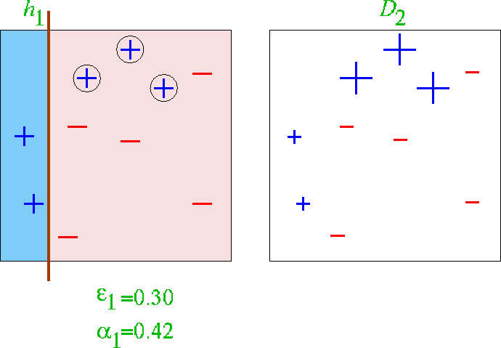
First classifier

Slide 56
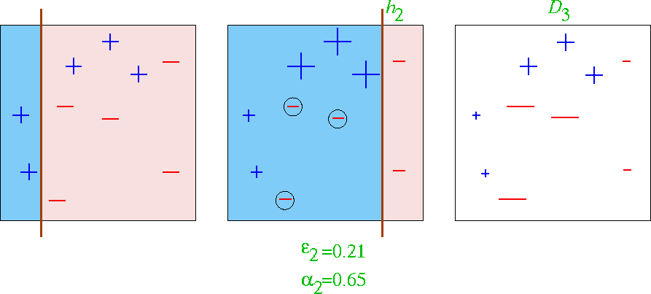
First 2 classifiers

Slide 57
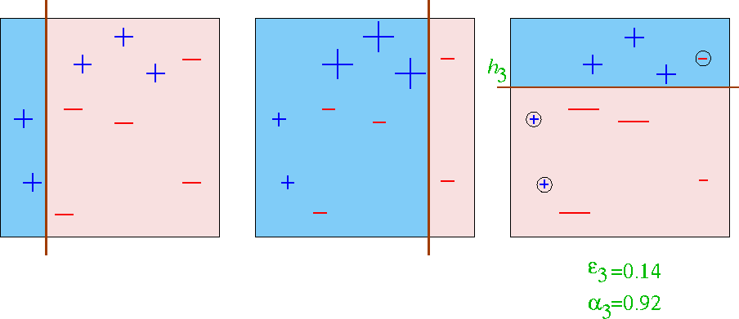
First 3 classifiers

Slide 58
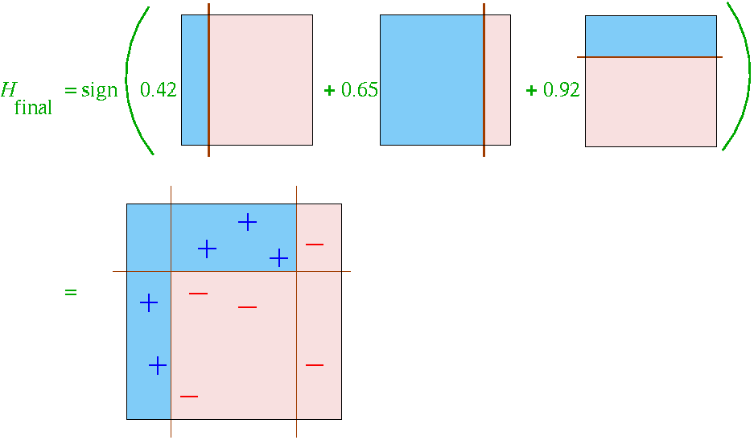
Final Classifier learned by Boosting

Slide 59
Final Classifier learned by Boosting

Slide 60
Boosting with Decision Stumps
Viola-Jones algorithm
  With K attributes (e.g., K = 160,000) we have 160,000 different decision stumps to choose from
  At each stage of boosting
    given reweighted data from previous stage
    Train all K (160,000) single-feature perceptrons
    Select the single best classifier at this stage
    Combine it with the other previously selected classifiers
    Reweight the data
    Learn all K classifiers again, select the best, combine, reweight
    Repeat until you have T classifiers selected
  Very computationally intensive
    Learning K decision stumps T times
    E.g., K = 160,000 and T = 1000

Slide 61
How is classifier combining done?
At each stage we select the best classifier on the current iteration and combine it with the set of classifiers learned so far
How are the classifiers combined?
  Take the weight*feature for each classifier, sum these up, and compare to a threshold (very simple)
  Boosting algorithm automatically provides the appropriate weight for each classifier and the threshold
  This version of boosting is known as the AdaBoost algorithm
  Some nice mathematical theory shows that it is in fact a very powerful machine learning technique

Slide 62
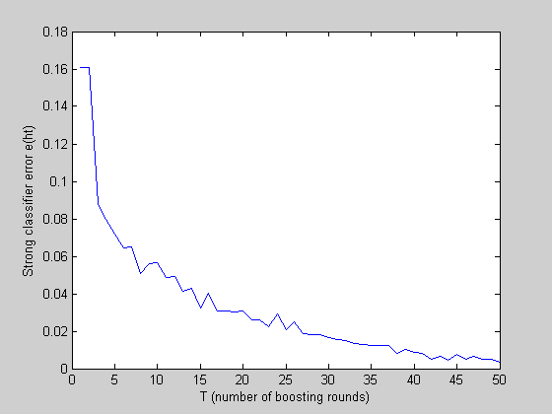
Reduction in Error as Boosting adds Classifiers

Slide 63
Useful Features Learned by Boosting

Slide 64
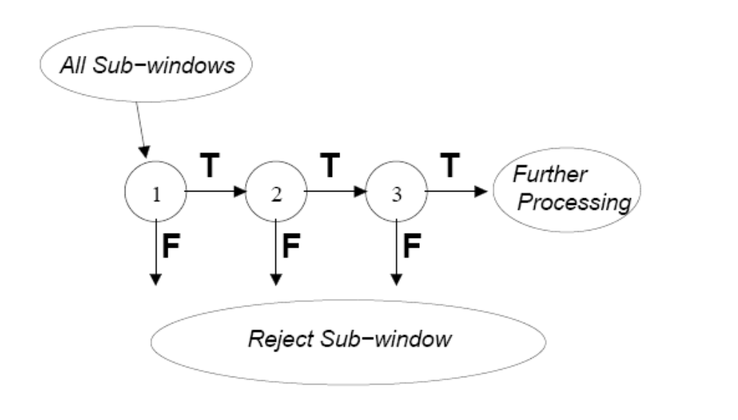
A Cascade of Classifiers

Slide 65
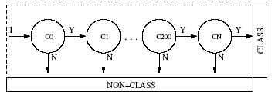
Cascade of Boosted Classifiers
Referred here as a degenerate decision tree.
  Very fast evaluation.
  Quick rejection of sub windows when testing.
Reduction of false positives.
  Each node is trained with the false positives of the prior.
AdaBoost can be used in conjunction with a simple bootstrapping process to drive detection error down.
  Viola and Jones present a method to do this, that iteratively builds boosted nodes, to a desired false positive rate.

Slide 66
Detection in Real Images
Basic classifier operates on 24 x 24 subwindows
Scaling:
  Scale the detector (rather than the images)
  Features can easily be evaluated at any scale
  Scale by factors of 1.25
Location:
  Move detector around the image (e.g., 1 pixel increments)
Final Detections
  A real face may result in multiple nearby detections
  Postprocess detected subwindows to combine overlapping detections into a single detection

Slide 67
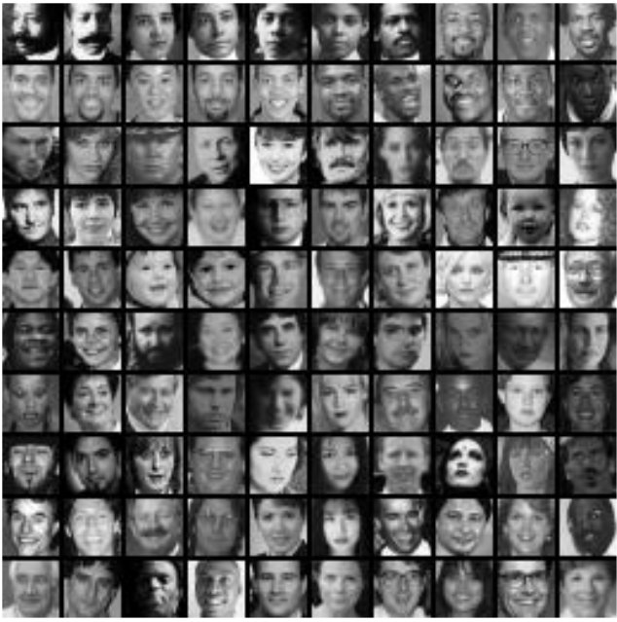
Training
Examples of 24x24 images with faces

Slide 68
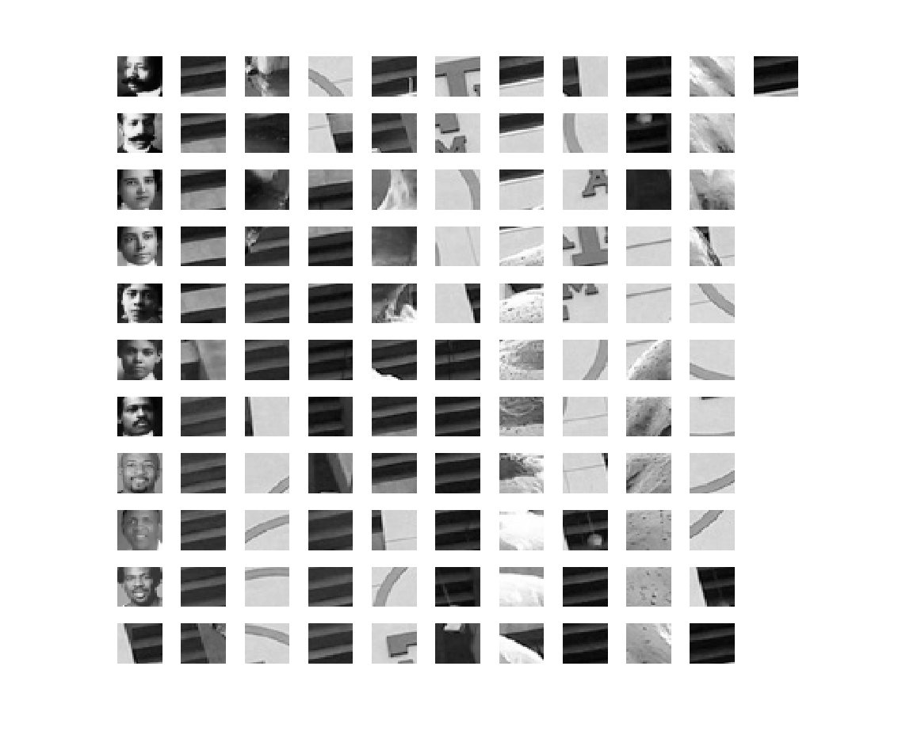
Small set of 111 Training Images

Slide 69
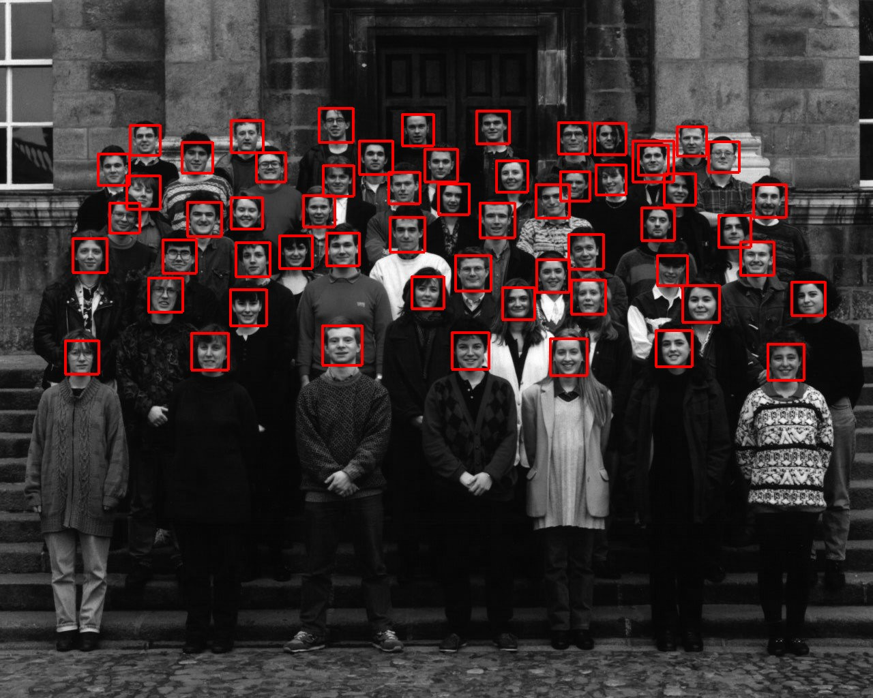
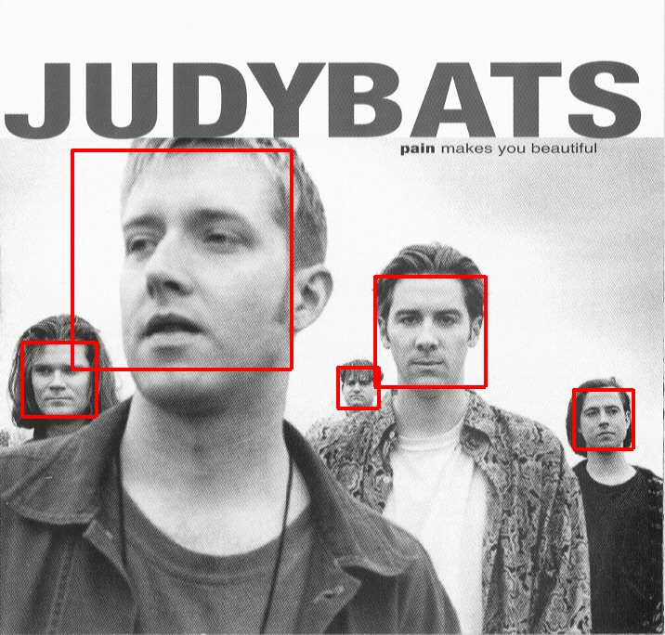
Sample results using the Viola-Jones Detector
Notice detection at multiple scales

Slide 70
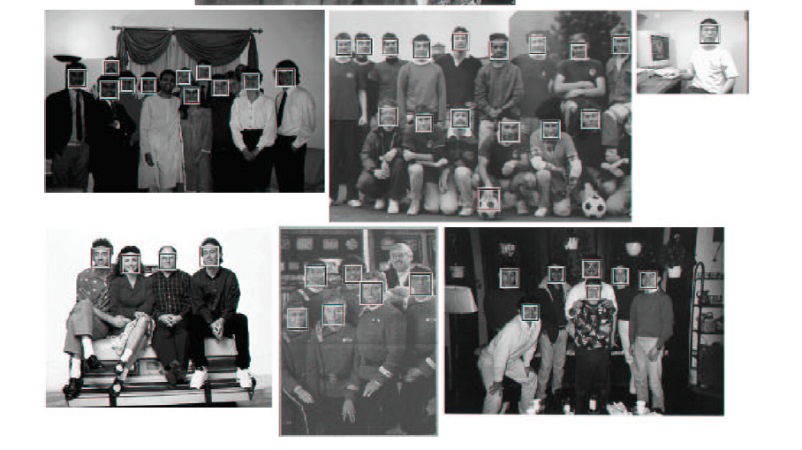
More Detection Examples

Slide 71
Practical implementation
Details discussed in Viola-Jones paper
Training time = weeks (with 5k faces and 9.5k non-faces)
Final detector has 38 layers in the cascade, 6060 features
700 Mhz processor:
  Can process a 384 x 288 image in 0.067 seconds (in 2003 when paper was written)

Slide 72
Summary
Inductive learning
  Error function, class of hypothesis/models {h}
  Want to minimize E on our training data
  Example: decision tree learning
Generalization
  Training data error is over-optimistic
  We want to see performance on test data
  Cross-validation is a useful practical approach
Learning to recognize faces
  Viola-Jones algorithm: state-of-the-art face detector, entirely learned from data, using boosting+decision-stumps

